Slide 1
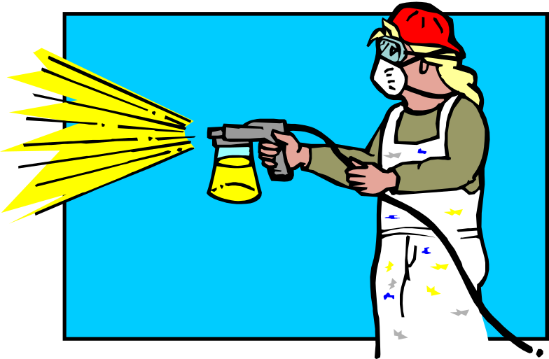

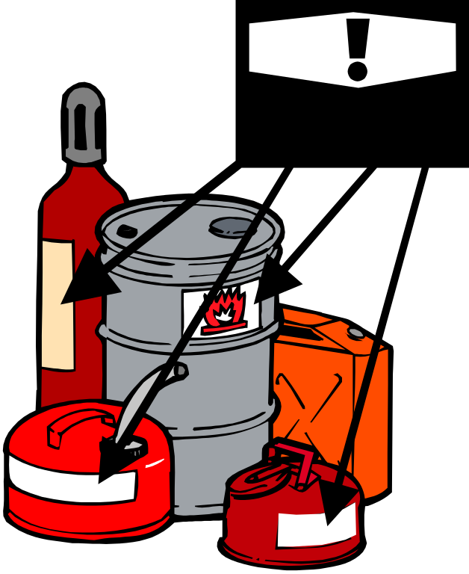
Subpart H
Hazardous Materials
CFR 1910.101-.126

Slide 2
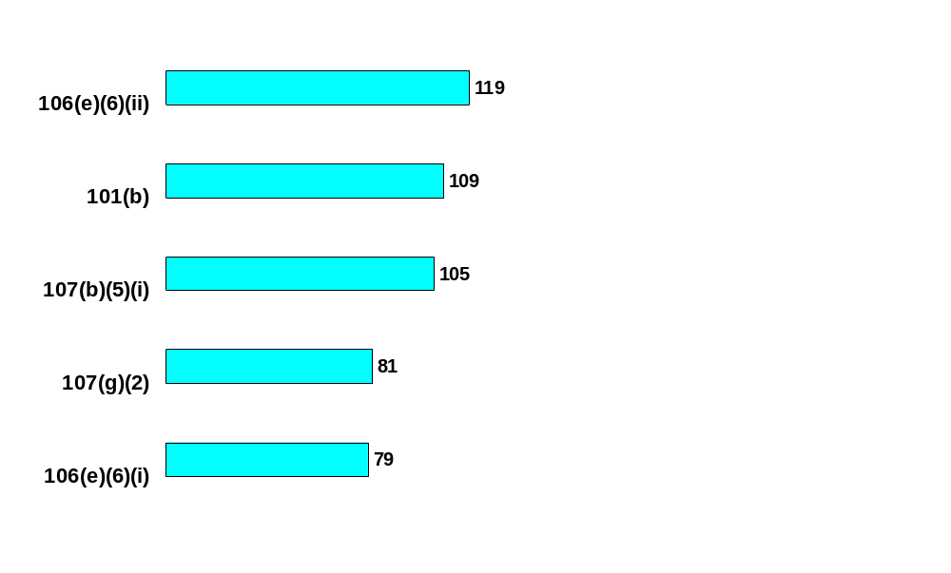
Subpart H - Hazardous Materials
(1910.101 - 126)
Class I liquids - Dispensing
*
Compressed gases - Handling, storage and use
*
Spray booth - Air velocity
*
Standard: 1910.
Spray areas – Free from combustible residue
*
Sources of ignition - Precautions
*
*Average number of Federal OSHA citations issued between 2000 and 2003

Slide 3
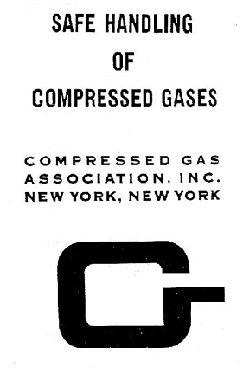

1910.101(b) Compressed gases
The in-plant handling, storage, and utilization of all compressed gases in cylinders, portable tanks, rail tankcars, or motor vehicle cargo tanks shall be in accordance with Compressed Gas Association (CGA) Pamphlet P-1-1965

Slide 4
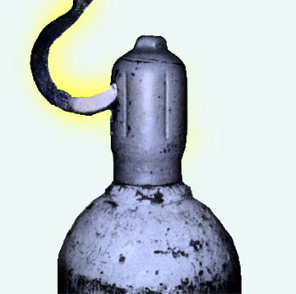
P-1 Section 3.2 Moving cylinders
3.2.2 Do not lift cylinders by the cap
3.2.3 Never drop cylinders nor permit them to strike against each other or against other surfaces violently

Slide 5

P-1 Section 3.2 Moving cylinders
Lifting magnet
3.2.4 Never handle a cylinder with a lifting magnet
3.2.5 Avoid dragging or sliding cylinders

Slide 6


P-1 3.3 Storing cylinders
3.3.6 Do not store cylinders near highly flammable substances such as oil, gasoline or combustible waste
Fire is a threat to containment!
MEK

Slide 7
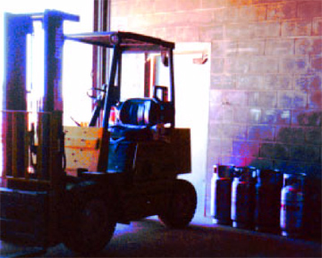
P-1 3.3 Storing cylinders
3.3.8 Do not store cylinders near elevators or gangways, or in locations where heavy moving objects may strike or fall on them
LP gas stored
near exit

Slide 8
P-1 3.4 Withdrawing cylinder content
3.4.2 If cylinder content is not identified by marking, return cylinder to the supplier without using
I’m not labeled!!
ACME
Cylinder Co

Slide 9

P-1 3.4.9 Safe work practices
Open cylinder slowly
Point valve opening away from yourself & others
Never use wrenches or tools except those provided by the supplier or approved by the gas manufacturer
Avoid the use of a wrench on a valve equipped with a handwheel

Slide 10
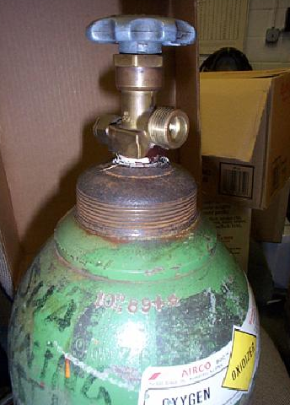
P-1 3.4.9 Safe work practices
Never hammer on the valve wheel
Frozen, corroded valves; contact the supplier
Use check valves if cylinder is apt to be contaminated by feedback of materials
Before removing a regulator, close the cylinder valve and release all the pressure from the regulator

Slide 11
P-1 3.5 Flammable gases
Indoor cylinder storage
Well protected
Well insulated
Dry
Twenty feet from flammable or combustible materials
Oxygen
Fuel
Gas
20 Feet

Slide 12

Flammable
and Combustible
Liquids
CFR 1910.106

Slide 13

Purpose of Standard
There are two primary hazards associated with flammable and combustible liquids: explosion and fire
In order to prevent these hazards, this standard addresses the primary concerns of:
  Design and construction,
  Ventilation,
  Ignition sources, and
  Storage

Slide 14
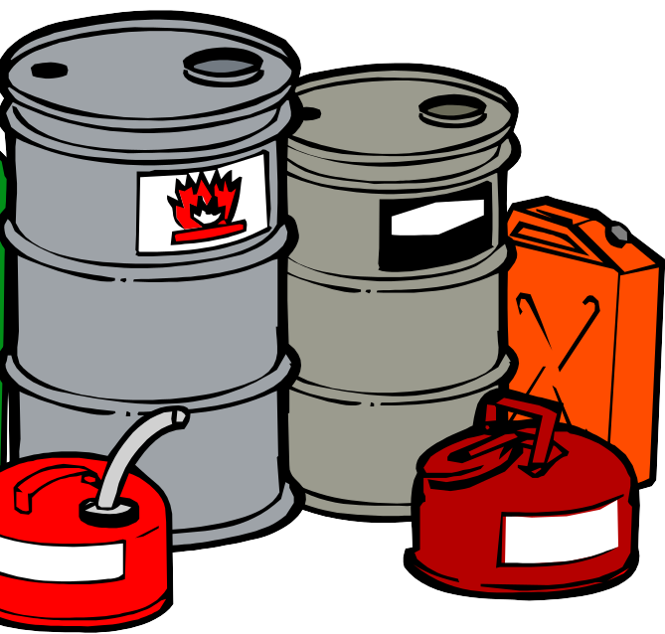

1910.106(d) Container and portable tank storage
Applies only to the storage of flammable or combustible liquids:
  Drums or other containers (including flammable aerosols) not exceeding 60 gallons individual capacity and
  Portable tanks not exceeding 660 gallons individual capacity

Slide 15
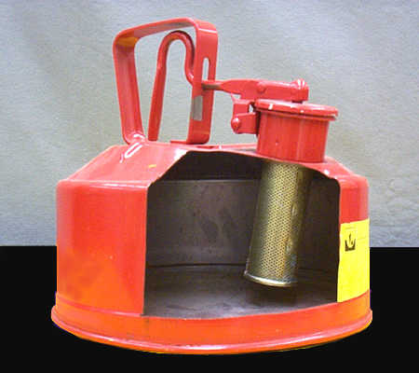
1910.106(d) Container and portable tank storage
Only approved containers and portable tanks shall be used
Metal containers and portable tanks meeting the requirements of and containing products authorized by chapter I, title 49 of the Code of Federal Regulations (regulations issued by the Hazardous Materials Regulations Board, Department of Transportation)

Slide 16
Standard Interpretations
06/22/1998 - Use of plastic containers and drums for flammable liquids storage
In your letter, you indicated that the Occupational Safety and Health Administration's (OSHA's) regulation, 29 CFR 1910.106, requires that such a mixture (Class 1C-flammable) be stored in a metal container.
Please note that due to progressing technology and information available after the issuance of OSHA's standard, OSHA has approved the usage of large plastic storage containers and drums for the storage of flammable liquids.

Slide 17
Standard Interpretations
06/22/1998 - Use of plastic containers and drums for flammable liquids storage
These containers, however, must be approved by either the Department of Transportation, or they must have been approved by a Nationally Recognized Testing Laboratory, in order to meet the intent of the standard.
Therefore, the Department of Transportation's acceptance of the plastic drums does not represent any conflict with current OSHA policy.

Slide 18

Flash Point
The minimum temperature at which a liquid gives off vapor within a test vessel in sufficient concentration to form an ignitable mixture with air near the surface of the liquid
Flash point is normally an indication of susceptibility to ignition

Slide 19
200 Fº
III
140 Fº
Combustible
Flash point > 100 Fº
II
Flash Point Fº
100 Fº
Flammable
Flash point < 100 Fº
IC
73 Fº
IA
IB
100 Fº
Boiling Point Fº

Slide 20

Ventilation
Ventilation as specified in this section is for the prevention of fire and explosion
It is considered adequate if it is sufficient to prevent accumulation of significant quantities of vapor-air mixtures in concentration over one-fourth of the lower flammable limit

Slide 21
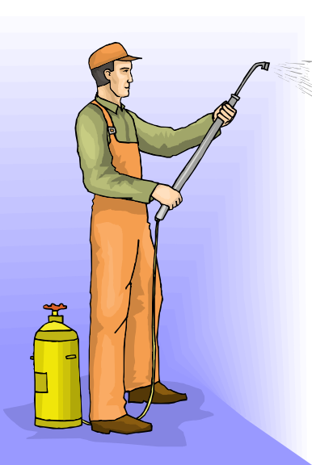

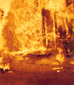
Flammable (Explosive) Limits
The flammable range includes all concentrations of flammable vapor or gas in air, in which a flash will occur or a flame will travel if the mixture is ignited
+
=

Slide 22
Flammable Range
Explosion Pressure
LEL
UEL
Vapor/Gas Concentration in Air (%)

Slide 23
1910.106(e) Industrial Plants
Use and handling of flammable or combustible liquids is only incidental to the principal business, such as:
Paint thinner storage in an automobile assembly plant;
Solvents used in the construction of electronic equipment,and;
Flammable finishing materials used in furniture manufacturing

Slide 24
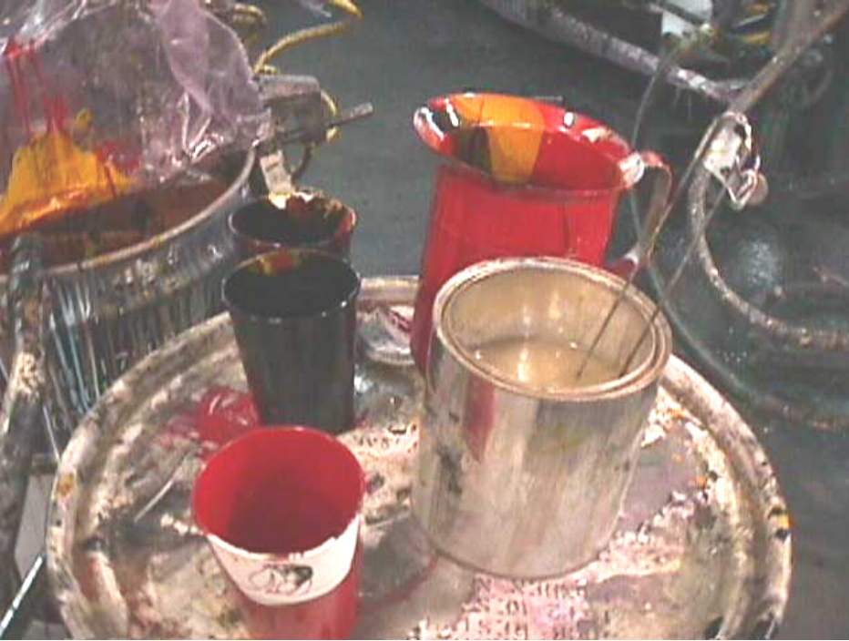
1910.106(e)(2(iv) Handling liquids at point of final use
Flammable liquids shall be kept in covered containers when not actually in use

Slide 25
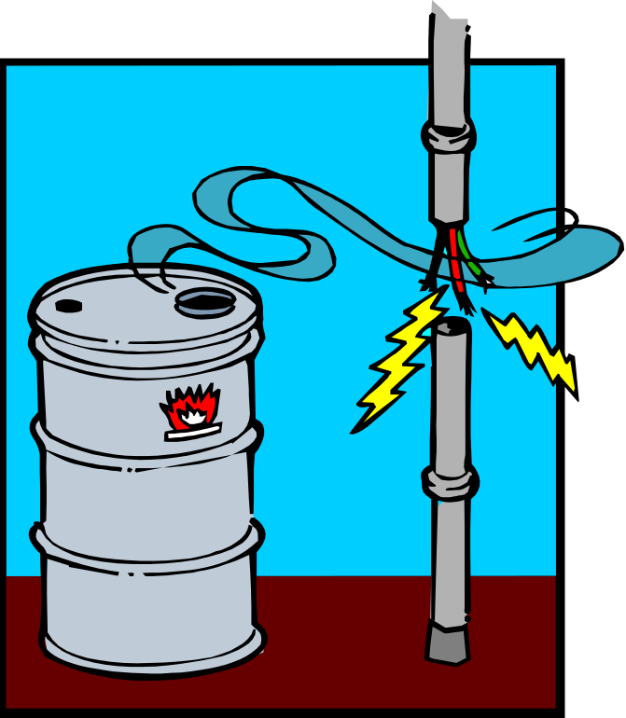
1910.106(e)(6) Sources of ignition
Adequate precautions shall be taken to prevent the ignition of flammable vapors

Slide 26

1910.106(e)(6) Sources of ignition
Sources of ignition may include:
  Open flames,
  Lightning,
  Smoking,
  Cutting and welding,
  Hot surfaces, frictional heat,
  Sparks (static, electrical, and mechanical),
  Spontaneous ignition,
  Chemical and physical-chemical reactions, and
  Radiant heat

Slide 27
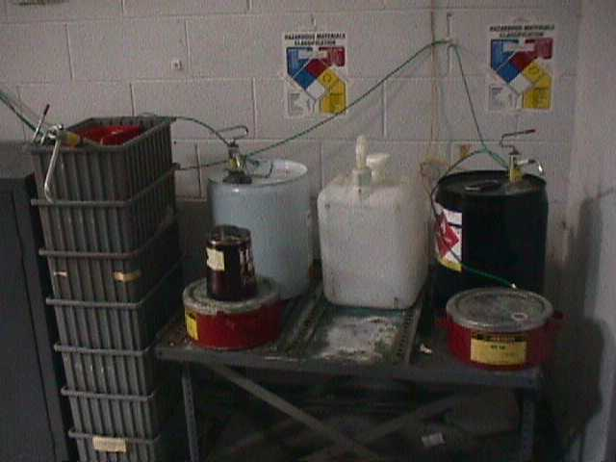
1910.106(e)(6) Sources of ignition
"Grounding." Class I liquids shall not be dispensed into containers unless the nozzle and container are electrically interconnected
Grounding and
bonding wires,
for dispensing
flammables

Slide 28


Process Safety Management
of
Highly Hazardous
Chemicals
CFR 1910.119

Slide 29
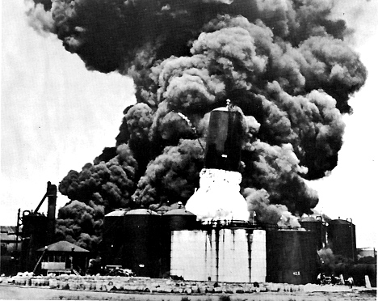
1910.119(a) Purpose
This section contains requirements for preventing or minimizing the consequences of catastrophic releases of:
  Toxic,
  Reactive,
  Flammable, or
  Explosive chemicals
These releases may result in toxic, fire or explosion hazards

Slide 30

1910.119(a)(1)Application
A process which involves a chemical at or above the specified threshold quantities listed in Appendix A
A process which involves a flammable liquid or gas (as defined in 1910.1200(c) of this part) on site in one location, in a quantity of 10,000 pounds (4535.9 kg) or more

Slide 31

1910.119(d) Process safety information
Pertaining to the hazards of the highly hazardous chemicals:
  Hazards of the process
  Technology of the process; and,
  The equipment in the process

Slide 32

1910.119(d) Process safety information
Toxicity information*;
  Permissible exposure limits;
  Physical data;
  Reactivity data:
  Corrosivity data;
  Thermal and chemical stability data; and
  Hazardous effects of inadvertent mixing of different materials that could foreseeably occur
*Note: Material Safety Data Sheets may be used to comply with this requirement to the extent they contain the information required

Slide 33
1910.123 Dipping and coating operations: Coverage and definitions
(a)(1) This rule (§§1910.123 through 1910.126) applies when you use a dip tank containing a liquid other than water. It applies when you use the liquid in the tank or its vapor to:
  Clean and object
  Coat an object
  Alter the surface of an object, or
  Change the character of an object

Slide 34
Standard Interpretations
04/26/1990 - The use of flammable and combustible liquids in dip tanks
OSHA does not exempt dip tanks from coverage on the basis of size or the volume of liquids held.
Your three to five gallon dip tank is regulated under our [1910.123-1910.126] standard.
There is no volume limit at which this regulation applies.

Slide 35
1910.124 General requirements for dipping and coating operations
(b)(1)The ventilation that you provide to a vapor area must keep the airborne concentration of any substance below 25% of its LFL.
When an employee enters a dip tank, you must meet the entry requirements of §1910.146, OSHA's standard for Permit-Required Confined Spaces, as applicable.

Slide 36
1910.124 General requirements for dipping and coating operations
Before permitting an employee to clean the interior of a dip tank, you must:
  (1)Drain the contents of the tank and open the cleanout doors; and
  (2)Ventilate and clear any pockets where hazardous vapors may have accumulated.

